Slide 1
CSE / T / 423C
Distributed Computing
Topic 9: Replication & Consistency
Sarbani Roy
Department of Computer Science & Engineering
Jadavpur University
E-mail: sarbani.roy@jadavpuruniversity.in
Room: CC-5-7
Phone: 9051639328

Slide 2
Replication
Replication involves creating and maintaining copies of services and data provided by a distributed system.
Unlike communication, without which it is impossible to build a distributed system, replication is not a fundamental principle.
  This means that it is possible to build a distributed system that does not make use of replication.
Maintenance of copies at multiple sites
  Enhanced performance
  High availability
  Fault tolerance

Slide 3
Replication: Reliability, Performance and scalability
Reliability: Creating many redundant copies of a service improves that service’s availability.
  With multiple servers available to clients, it is less likely that a malfunction of one of them will render the whole service unavailable.
  Likewise, if the data on a server becomes corrupt, data stored at replicas can be used to restore the correct state.
Performance: replicating services helps to reduce the load on individual servers.
  Likewise, by placing replicas close to clients the impact of communication can be greatly reduced.
Scalability: as a service grows, creating more replicas allows the service to scale along with the growth.

Slide 4
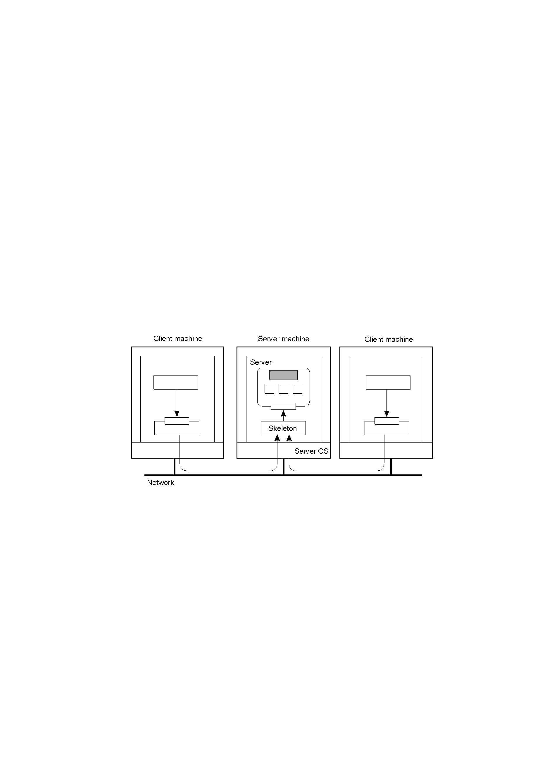
Object Replication (I)
A distributed remote object shared by two different clients.
The object itself can handle concurrent operations
... OR:
The server protects the object in the presence of concurrency

Slide 5
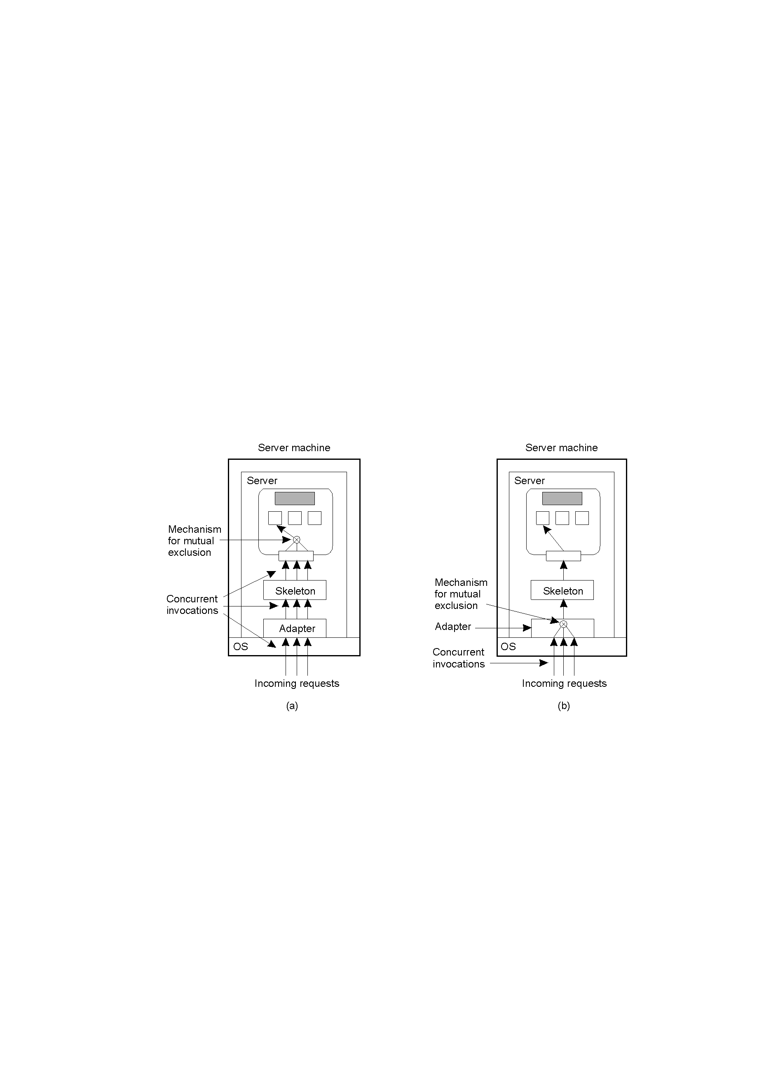
Object Replication (II)
A remote object capable of handling concurrent invocations on its own.
A remote object for which an object adapter is required to handle concurrent invocations
Concurrency-aware objects vs system-managed concurrency

Slide 6
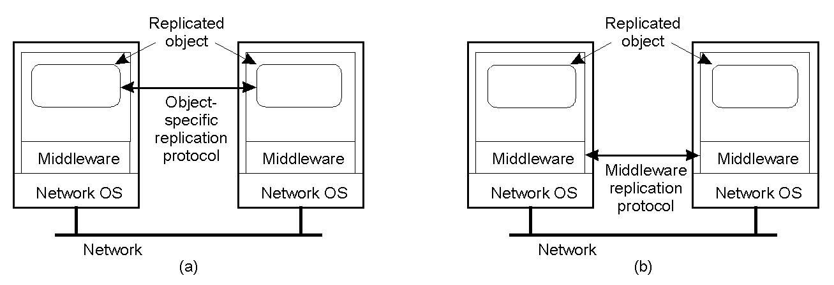
Object Replication (III)
Replication-aware objects can adopt object-specific policies
Replication-aware distributed objects.
A distributed system responsible for replica management

Slide 7
Data & Control Replication
Data replication: only a service’s data is replicated.
  Processing and manipulation of the data is performed either by a non-replicated server, or by clients accessing the data.
  A typical example of data replication is a replicated (also known as mirrored) FTP site. Web browsers with caches are another example of data replication.
Control replication: only the control part of the service is replicated while the data remains at a single centralized server.
  This form of replication is generally used to improve or maintain performance by spreading the computational load over multiple servers.
Combination of data and control replication: both the data and control are replicated.
  They may be replicated together (i.e., both control and data are placed on the same replica servers), or separately (i.e., data is replicated on different servers than control).

Slide 8
Issues that must be addressed
The most important of these is keeping the copies of replicated data consistent.
How replicas propagate updates amongst each other,
Where to place the replicas,
How many replicas to create,
When to add and remove replicas, etc.

Slide 9
Distributed Data-Store
A data store is a generic term for a service that stores data. Examples of data stores include:
  shared memory, databases, file systems, objects, web servers, etc.
A data store stores data items (depending on the data store, a data item could be a page of memory, a record, a file, a variable, a Web page, etc.).
Clients wishing to access data from a data store connect to the data store and perform read and write operations on it.
The exact nature of a client connection depends on the underlying data store and could be through a network connection or direct access.

Slide 10
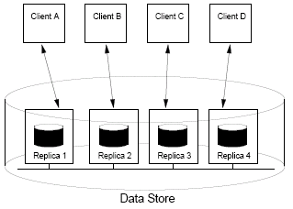
The data store model
From a client’s point of view a data store acts like a centralized service hosted on a single server.
Internally, however, the data store consists of multiple servers (called replica servers) each containing a copy of all the data items stored in the data store.
Each replica server runs a replica manager process, which receives operation invocation requests from clients and executes the operations locally on its copy of the data.
The replica manager is also responsible for communicating with replica managers running on the other replica servers.
A client always connects to a single replica.

Slide 11
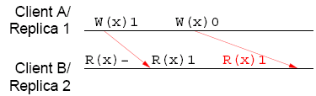
An example timeline of two clients accessing a distributed data-store
The operations performed by clients on a data store will be represented on a time line, an example of which is shown in this Figure. In this figure, time flows to the right (the figure assumes an absolute global time, and the position of the operations on the timeline reflect their ordering according to this time).
For the operations there are three relevant times: the time of issue, the time of execution, and the time of completion.
Arrows show the time of execution of operations on remote replicas.
  Read operations are always performed locally, while writes are assumed to be performed locally first and then propagated to remote replicas.

Slide 12
Consistency
It must be ensured during data replication that when one copy of the data is updated all the other copies are updated too.
Depending on how and when these updates are executed we can get inconsistencies in the data store (i.e., all the copies of the data are not the same).
There are two ways in which the data store can be inconsistent.
  First the data could be stale, that is, the data at some replicas has not been updated, while others have. Staleness is typically measured using time or versions. As long as updates are reliably propagated to all replicas, given enough time (and a lack of new updates) stale data will eventually become up to date.
  The other type of inconsistency occurs when operations are performed in different orders at different replicas. Applying operations in different orders can lead to different results that cannot be consolidated by simply ensuring that all replicas have received all updates.

Slide 13
Conflicting operations
Because clients on different machines can access the data store concurrently, it is possible for clients to invoke conflicting operations.
Two (or more) operations on the same data item are conflicting if they may occur concurrently (that is each is invoked by a different client), and at least one of them is a write.
  read-write conflicts (where only one operation is a write) and
  write-write conflicts (where more than one operation is a write).
Partial ordering: all operations executed at a single replica occur in a particular order.
Total ordering: interleaving of all the partial orderings into a single timeline (as though the operations were all performed on a single non-replicated data store).

Slide 14
Consistency Model
Contract between data store & processes
  Rules for processes to obey
  Data store’s expected behavior
Strict consistency
  Read is expected to return the value resulting from the most recent write operation
  … assumes absolute global time
  All writes are instantaneously visible to all
Sequential consistency
  All processes see the same interleaving of operations
Relaxed consistency models
A consistency model effectively restricts the values that a read operation can return …

Slide 15
Strict Consistency
The strict consistency model requires that any read on a data item returns a value corresponding to the most recent write on that data item.
  This is what one would expect from a single program running on a uniprocessor.
  A problem with strict consistency is that the interpretation of ‘most recent’ is not clear in a distributed data store.
A strict interpretation requires that all clients have a notion of an absolute global time. It also requires instant propagation of writes to all replicas.
Due to the fact that it is not possible to achieve absolute global time in a distributed system and the fact that communicating between replicas can never be instantaneous, strict consistency is impossible to implement in a distributed data store.

Slide 16
Strict Consistency (I)
Suppose that x is stored only on host B
At time t1, a process on host A “reads” x
  … thereby sending a message to host B
At time t2 > t1, a process on B “writes” x
Strict consistency → The process on host A must obtain the previous value of x
  … regardless of the interval (t2 – t1)
  What happens if t2 – t1 = 3 nsec, and A-to-B is a 3-meter segment of optical fiber ??

Slide 17

Strict Consistency (II)
Impossible to implement in a distributed system !
(assumes all writes are instantaneously visible to all processes)
Behavior of two processes, operating on the same data item.
(a) A strictly consistent store.
(b) A store that is not strictly consistent.

Slide 18
Linearizable consistency
A model that is close to strict consistency, but that is possible to implement in a distributed data store, is the linearizable consistency model.
In this model the requirement of absolute global time is dropped. Instead all operations are ordered according to a timestamp taken from the invoking client’s loosely synchronized local clock.
Linearizable consistency requires that all operations be ordered according to their timestamp. This means that all operations are executed in the same order at all replicas.
Note that although it is possible for a distributed data store to implement this model, it is still very expensive to do so. For this reason linearizable consistency is rarely implemented.

Slide 19
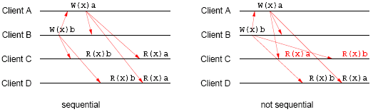
Linearizability & Sequential Consistency (I)
All processes agree on the same interleaving of operations
A sequentially consistent data store.
A data store that is not sequentially consistent.
Time does not play a role !

Slide 20
Linearizability & Sequential Consistency (II)
Process P1 | Process P2 | Process P3
x = 1; print ( y, z); | y = 1; print (x, z); | z = 1; print (x, y);
Three concurrently executing processes.
With 6 independent statements→ 720 (6!) possible execution sequences….some execution sequences
(that do not violate program order)
The processes must accept all of them as valid

Slide 21
Linearizability & Sequential Consistency (III)
Four valid execution sequences for the processes of the previous slide … each yielding a different result.
x = 1; print (y, z); y = 1; print (x, z); z = 1; print (x, y); Prints: 001011 Signature: 001011 (a) | x = 1; y = 1; print (x,z); print(y, z); z = 1; print (x, y); Prints: 101011 Signature: 101011 (b) | y = 1; z = 1; print (x, y); print (x, z); x = 1; print (y, z); Prints: 010111 Signature: 110101 (c) | y = 1; x = 1; z = 1; print (x, z); print (y, z); print (x, y); Prints: 111111 Signature: 111111 (d)

Slide 22
Causal Consistency (I)
Often the requirement that all operations are seen in the same order is not important.
The causal consistency model weakens sequential consistency by requiring that only causally related write operations are executed in the same order on all replicas.
Two writes are causally related if the execution of one write possibly influences the value written by the second write. Specifically two operations are causally related if:
  A read is followed by a write in the same client
  A write of a particular data item is followed by a read of that data item in any client.
If operations are not causally related they are said to be concurrent. Concurrent writes can be executed in any order, as long as program order is respected.

Slide 23
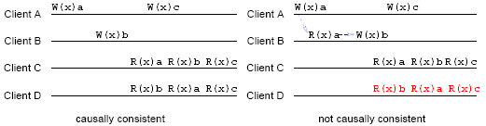
An example of a valid and an invalid ordering of operations for the causal consistency model
In the example of an invalid ordering we see that the write performed by client B (W(x)b) is causally related to the previous write performed by client A (W(x)a). As such, these writes must appear in the same (causal) order at all replicas. This is not the case for client D where we see that W(x)a is executed after W(x)b.

Slide 24
FIFO Consistency (I)
The FIFO (or Pipelined RAM) consistency model, weakens causal consistency in that it removes limitations about the order of any concurrent operations.
FIFO consistency requires only that any total ordering respect the partial orderings of operations (i.e., program order).
Necessary Condition:
Writes done by a single process are seen by all other processes in the order in which they were issued,
… but writes from different processes may be seen in a different order by different processes.

Slide 25
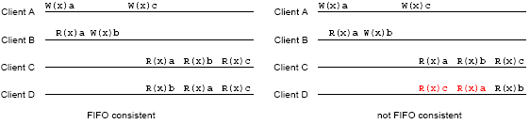
FIFO Consistency (II)
An example of a valid and an invalid ordering of operations for the FIFO consistency model

Slide 26
Others
Previous consistency models specified the ordering requirements for all operations on the data store.
Some data-centric models drop this requirement dealing instead with the ordering of groups of instructions.
They do this by defining groups of operations (comparable to critical sections) and only dictating requirements for the ordering of these groups, rather than individual operations.

Slide 27
Weak Consistency
The first of these models is the weak consistency model. In this model critical sections are delimited using operations on synchronization variables (e.g., locks).
In this model performing a synchronize operation on a synchronization variable causes the following to happen.
  First, all local writes are completed and the updated data items are propagated to all other replicas.
  Second, all updates from other clients are executed locally (that is, the replica makes sure that its copy of the data is up-to-date).
Essentially, weak consistency imposes a sequentially consistent ordering of synchronize operations.

Slide 28
Release consistency model
The functionality of the synchronize operation as defined in the weak consistency model can be split into two separate functions:
  bringing local state up-to-date and
  propagating local updates to all other replicas.
The release consistency model makes the distinction between the two functions explicit by associating the
  first with an acquire() operation and
  the second with a release() operation.
The model requires a client to call acquire() when entering a critical section and release() when leaving it. This ensures that when entering a critical section all data is up-to-date, while when leaving the section all updates are made available to other replicas.

Slide 29

Release Consistency (I)
Distinguish entry/exit in a critical section
release →updates of protected data are propagated
Does not necessarily import updates from other copies
Protected shared data
A valid event sequence for release consistency.

Slide 30
Lazy release consistency
A slight modification of the release consistency model, called lazy release consistency, requires that updates are only propagated and executed when an acquire() operation is performed.
This saves much communication when a critical section is performed repeatedly by a single client.

Slide 31
Entry consistency model
The entry consistency model is similar to lazy release consistency,
Except that the synchronization variables are explicitly associated with specific data items.
These data items are called guarded data-items.
  In order to write to a guarded data-item a client must acquire that item’s synchronization variable in exclusive mode. This means that no other clients can hold that variable.
  When the client is done updating the data item it releases the associated synchronisation variable.
  When a client wishes to read a particular data item it must acquire the associated synchronisation variable in nonexclusivemode.

Slide 32

Entry Consistency (I)
Each shared data item needs to be
associated with a sync. variable (lock)
Only data guarded by a
lock are kept consistent
Can be done implicitly
(by the run-time system)
Current owner per sync. variable
Acquire makes visible all remote changes to the guarded data
A valid event sequence for entry consistency.

Slide 33
Summary of Consistency Models
Consistency | Description
Strict | Absolute time ordering of all shared accesses matters.
Linearizability | All processes must see all shared accesses in the same order. Accesses are furthermore ordered according to a (nonunique) global timestamp
Sequential | All processes see all shared accesses in the same order. Accesses are not ordered in time
Causal | All processes see causally-related shared accesses in the same order.
FIFO | All processes see writes from each other in the order they were used. Writes from different processes may not always be seen in that order
 | (a)
Consistency | Description
Weak | Shared data can be counted on to be consistent only after a synchronization is done
Release | Shared data are made consistent when a critical region is exited
Entry | Shared data pertaining to a critical region are made consistent when a critical region is entered.
 | (b)

Slide 34
Client-centric Consistency Models
The data-centric consistency models had an underlying assumption that the number of reads was approximately equal to the number of writes, and that concurrent writes occur often.
Client-centric consistency models, on the other hand, assume that clients perform more reads than writes and that there are few concurrent writes.
  They also assume that clients can be mobile, that is, they will connect to different replicas during the course of their execution.

Slide 35
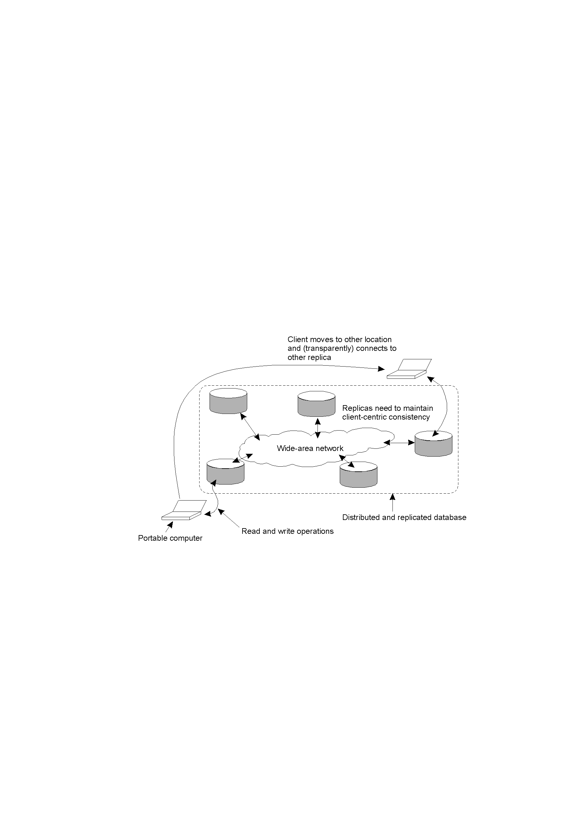
Eventual Consistency
The principle of a mobile user accessing different replicas of a distributed database.
If no updates take place for some time, all replicas
gradually converge to a consistent state …

Slide 36

Monotonic Reads
WS(x₁) is part of WS(x₂)
If a process has seen a
value of x at time t, it
will never see an older
value at a later time.
Example:
replicated mailboxes with
on-demand propagation
of updates
The read operations performed by a single process P at two different local copies of the same data store.
A monotonic-read consistent data store
A data store that does not provide monotonic reads.

Slide 37

Monotonic Writes
If an update is made to a
copy, all preceding updates
must have been completed first.
A write may affect only part of the
state of a data item
FIFO propagation of
updates by each process
Example:
- s/w library
No guarantee that x at L2 has the same
value as x at L₁ at the time W(x1) completed
The write operations performed by a single process P at two different local copies of the same data store
A monotonic-write consistent data store.
A data store that does not provide monotonic-write consistency.

Slide 38

Read Your Writes
A write is completed before a successive read, no matter where the read takes place
examples:
updates of Web pages
changes of passwords
The effects of the previous write
at L1 have not yet been propagated !
A data store that provides read-your-writes consistency.
A data store that does not.

Slide 39

Writes Follow Reads
Any successive write will be performed on a copy that is up-to-date with the value most recently read by the process.
Example:
updates of a newsgroup:
Responses are visible only after
the original posting has been received
A writes-follow-reads consistent data store
A data store that does not provide writes-follow-reads consistency

Slide 40
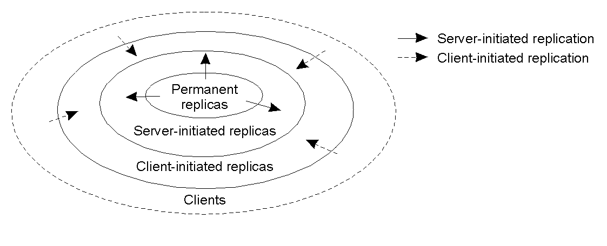
Replica Placement (I)
The logical organization of different kinds of copies of a data store into three concentric rings.

